Slide 1
Evolution and History of Programming Languages(Lec 1c)
KARATINA UNIVERSITY
P Kariuki
memekariuki@gmail.com

Slide 2
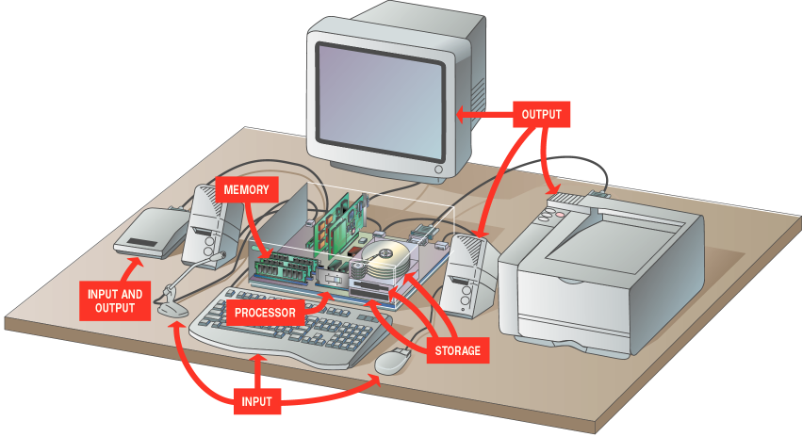
Evolution and History of Programming Languages

Slide 3
DEFINITION: STRUCTURED PROGRAMMING
A technique for organizing and coding computer programs in which a hierarchy of modules is used, each having a single entry and a single exit point, and in which control is passed downward through the structure without unconditional branches to higher levels of the structure.
(sometimes known as modular programming) is a subset of procedural programming that enforces a logical structure on the program being written to make it more efficient and easier to understand and modify.

Slide 4
DEFINITION: MODULAR PROGRAMMING
Modular programming is defined as organizing a program into small, independent modules that are separately named and individually invoke able program elements. These modules are integrated to become a software system that satisfies the problem requirements.

Slide 5
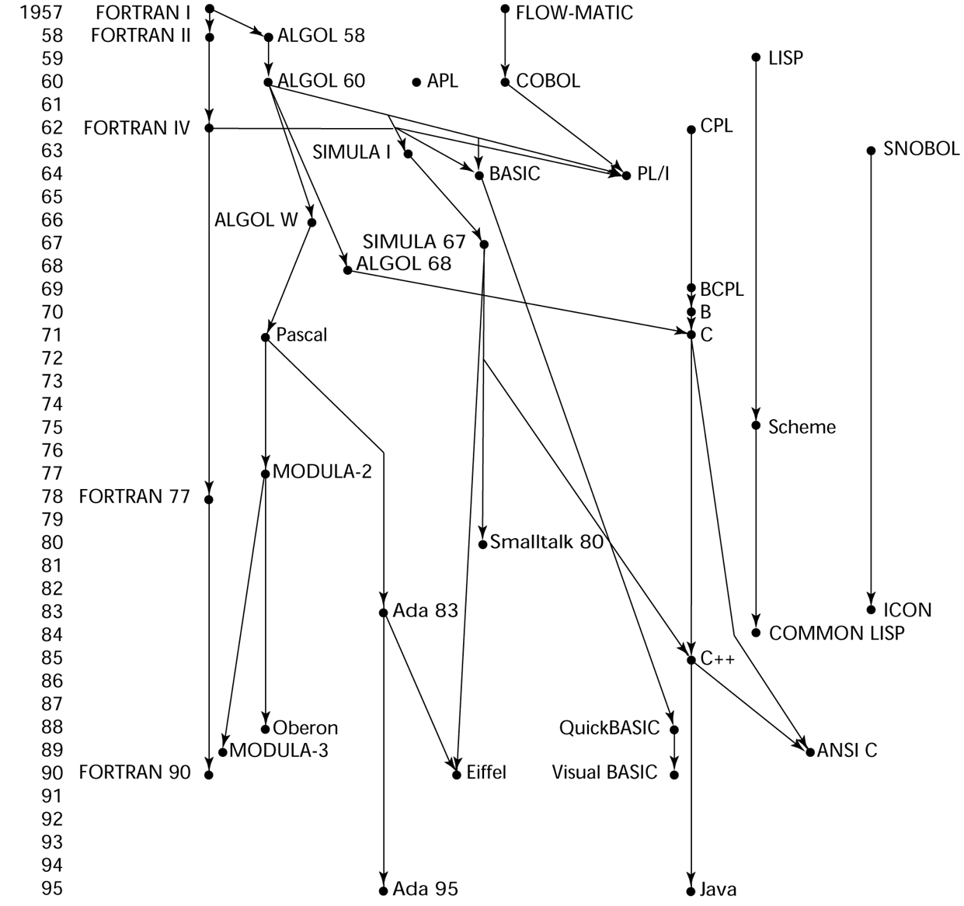
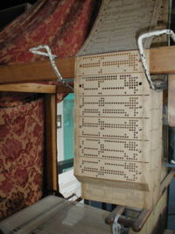
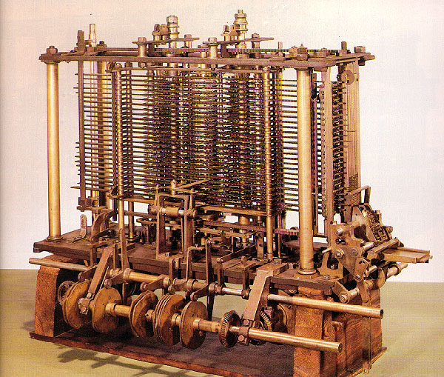
History Timeline

Slide 6
The Evolution of Programming Languages
To build programs, people use languages that are similar to human language. The results are translated into machine code, which computers understand.
Programming languages fall into three broad categories:
Machine languages
Assembly languages
Higher-level languages

Slide 7
The Evolution of Programming Languages -
Machine Languages
Machine languages (first-generation languages) are the most basic type of computer languages, consisting of strings of numbers the computer's hardware can use.
Different types of hardware use different machine code. For example, IBM computers use different machine language than Apple computers.

Slide 8
The Evolution of Programming Languages - Assembly Languages
Assembly languages (second-generation languages) are only somewhat easier to work with than machine languages.
To create programs in assembly language, developers use cryptic English-like phrases to represent strings of numbers.
The code is then translated into object code, using a translator called an assembler.

Slide 9
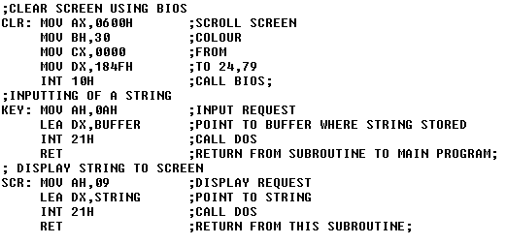
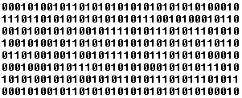
Assembly
code
Assembler
Object code

Slide 10
The Evolution of Programming Languages -
Higher-Level Languages
Higher-level languages are more powerful than assembly language and allow the programmer to work in a more English-like environment.
Higher-level programming languages are divided into three "generations," each more powerful than the last:
Third-generation languages
Fourth-generation languages
Fifth-generation languages

Slide 11
Higher-Level Languages -
Third-Generation Languages
Third-generation languages (3GLs) are the first to use true English-like phrasing, making them easier to use than previous languages.
3GLs are portable, meaning the object code created for one type of system can be translated for use on a different type of system.
The following languages are 3GLs:
FORTAN C
COBOL C++
BASIC Java
Pascal ActiveX

Slide 12
Higher-Level Languages -
Fourth-Generation Languages
Fourth-generation languages (4GLs) are even easier to use than 3GLs.
4GLs may use a text-based environment (like a 3GL) or may allow the programmer to work in a visual environment, using graphical tools.
The following languages are 4GLs:
Visual Basic (VB)
VisualAge
Authoring environments

Slide 13
Higher-Level Languages -
Fifth-Generation Languages
Fifth-generation languages (5GLs) are an issue of debate in the programming community – some programmers cannot agree that they even exist.
These high-level languages would use artificial intelligence to create software, making 5GLs extremely difficult to develop.
Solve problems using constraints rather than algorithms, used in Artificial Intelligence
    Prolog

